Slide 1



Water Quality prediction

Slide 2

Understand Water Quality Parameters Learn how features like pH, turbidity, and dissolved oxygen affect water quality.
Data Preprocessing & Feature Engineering Clean, normalize, and select relevant features from the dataset.
Build and Train Models Implement Linear Regression and Random Forest Regression for prediction.
Model Evaluation Analyze model performance using RMSE and R² Score.
Model Comparison Compare results to identify the most accurate and efficient model.
Visualization & Interpretation Use plots and feature importance to interpret model output.
Real-world Applications Apply models to predict water safety for environmental monitoring.
Learning Objectives
GOAL
Source :
www.freepik.com/

Slide 3
Programming Language
Python – for data analysis, model building, and visualization.
Libraries & Frameworks
Pandas – for data manipulation.
NumPy – for numerical operations.
Matplotlib / Seaborn – for data visualization.
Scikit-learn – for machine learning models and evaluation metrics.
Machine Learning Models
Linear Regression
Random Forest Regression
Model Evaluation
RMSE (Root Mean Squared Error)
R² Score (Coefficient of Determination)
Development Environment
Jupyter Notebook / Google Colab / VS Code
Tools and Technology used

Slide 4
Data Collection Collected water quality data from public sources (e.g., Kaggle, UCI).
Data Preparation Cleaned, normalized, and selected key features for modeling.
Model Selection Chose Linear Regression and Random Forest Regression for prediction.
Model Training Trained models using train-test split to learn patterns from the data.
Model Evaluation Evaluated using RMSE and R² Score to measure accuracy and error.
Local Deployment Deployed the model using Flask or Streamlit for real-time predictions.
Methodology

Slide 5
Problem Statement:
Access to clean and safe water is essential for health, agriculture, and industry. However, monitoring water quality manually is time-consuming, expensive, and often delayed.
There is a need for an automated, data-driven solution to predict water quality levels accurately using machine learning, based on measurable parameters like pH, turbidity, dissolved oxygen, and conductivity.
This project aims to develop a predictive model that can assist government agencies, industries, and communities in making timely decisions about water usage and treatment.

Slide 6
Solution:
To address the issue of delayed and manual water quality testing, a machine learning-based predictive model was developed.
Used Random Forest Regression (RFR) to build a robust and accurate prediction model.
Trained the model on historical water quality data with features like:
Dissolved Oxygen (DO), pH, Turbidity, Conductivity, Temperature, etc.
The model learns patterns from pollutant levels and predicts the Water Quality Index (WQI) or other quality indicators.
Evaluated using RMSE and R² Score for accuracy.
Deployed locally using Flask/ Streamlit to provide real-time water quality predictions based on input parameters.

Slide 7
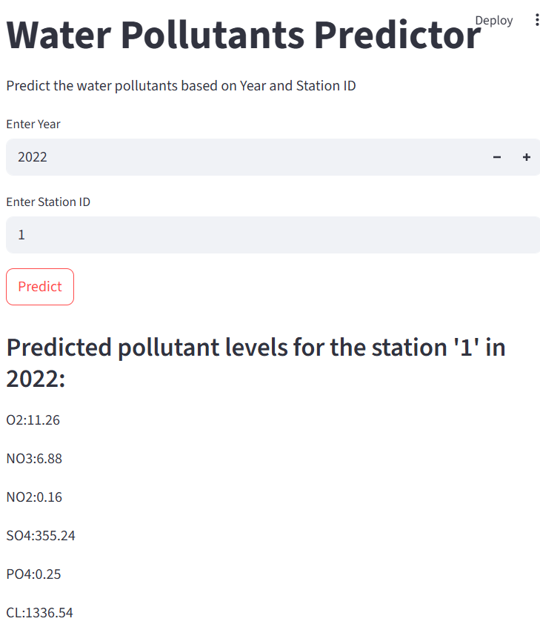
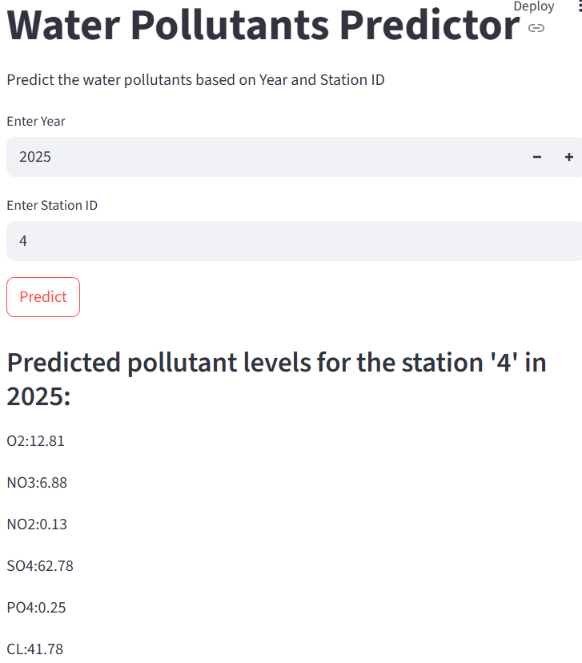
Screenshot of Output:

Slide 8
Conclusion:
Potability determines the quality of water, which is one of the most important resources for existence. Traditionally, testing water quality required an expensive and time-consuming lab analysis. This study looked into an alternative machine learning method for predicting water quality using only a few simple water quality criteria. To estimate, a set of representative supervised machine learning algorithms was used. It would detect water of bad quality before it was released for consumption and notify the appropriate authorities It will hopefully reduce the number of individuals who drink low-quality water, lowering the risk of diseases like typhoid and diarrhea. In this case, using a prescriptive analysis based on projected values would result in future capabilities to assist decision and policy makers

